Slide 1
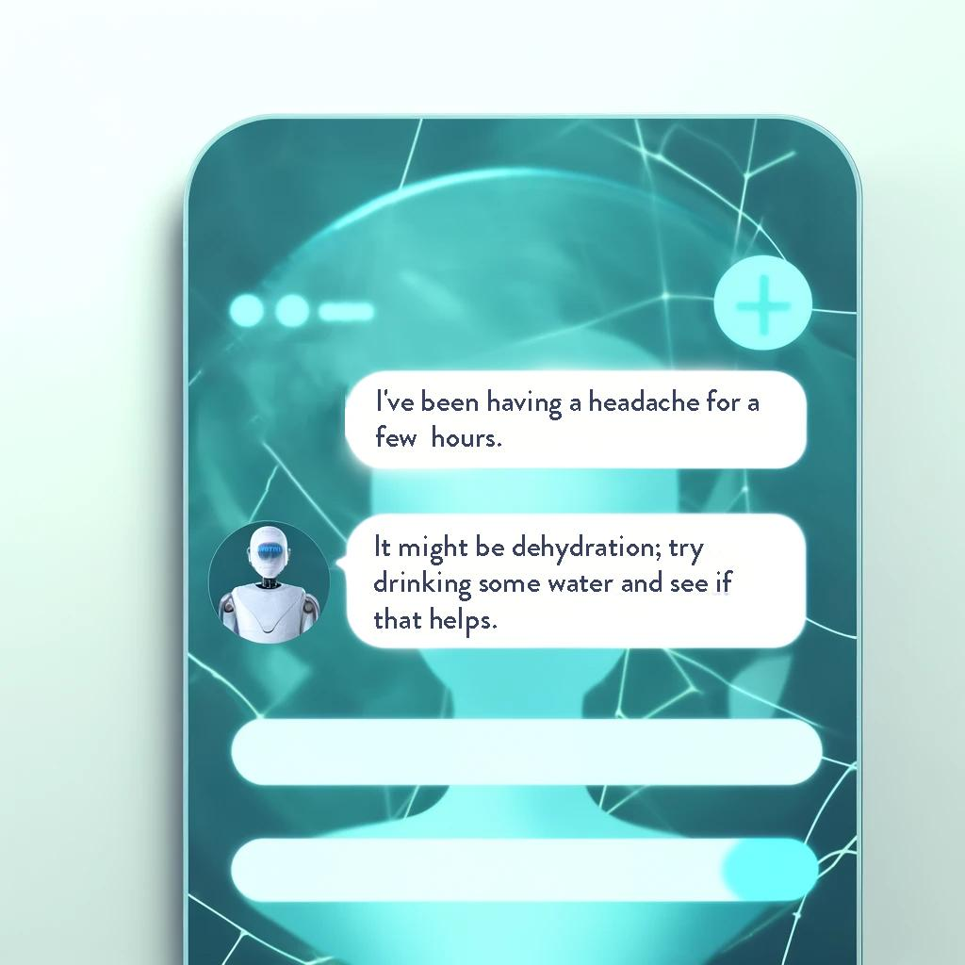
MediQA Chatbot 🤖🧠🩺
Md. Shafi Ud Doula -st124047
Sonu Adhikari-st124409
Ashmita Phuyal-st124454
Tanzil Al Sabah-st123845
Sai Haneesha Bestha-st124089
Course: Artificial Intelligence: Natural Language Understanding Course Instructor: Dr. Chaklam Silpasuwanchai

Slide 2
Content
1
2
3
Introduction &
Objective
Problem Statement
Solution Requirements
System Architecture
& Methodology
4
5
6
Data Preprocessing,
Results & Evaluation
Demo
Application
Limitation, Future Works & Conclusion

Slide 3
MediQA Chatbot 🤖🧠🩺
– Objective & Goals–
– Introduction & Background –
Improve Health Literacy: Enhance users' understanding of health issues, enabling informed decisions about their medical care.
Provide Timely Access to Data: Offer 24/7 access to clinical data, facilitating timely health decisions and actions.
Demonstrate NLP Application: Showcase the practical use of NLP in improving patient satisfaction and healthcare usability in our NLP course project.
An AI-driven virtual assistant that utilizes advanced NLP techniques to provide immediate and personalized medical information, helping users make informed healthcare decisions.

Slide 4
Problem Statement & Solution Requirements
– Problem –
– Solution Requirements –
Limited healthcare expert availability due to systemic constraints and logistical issues.
Delays in medical attention owing to inadequate knowledge or understanding of symptom severity.
Conventional chatbots have limitations in natural language understanding and adaptability, affecting accuracy.
Utilize advanced NLP for accurate comprehension of user queries and responses.
Integrate with a constantly updated medical knowledge base.
Conduct trials to identify the most effective model.
Ensure smooth integration with a web application
Offer a user-friendly interface to increase user satisfaction.

Slide 5
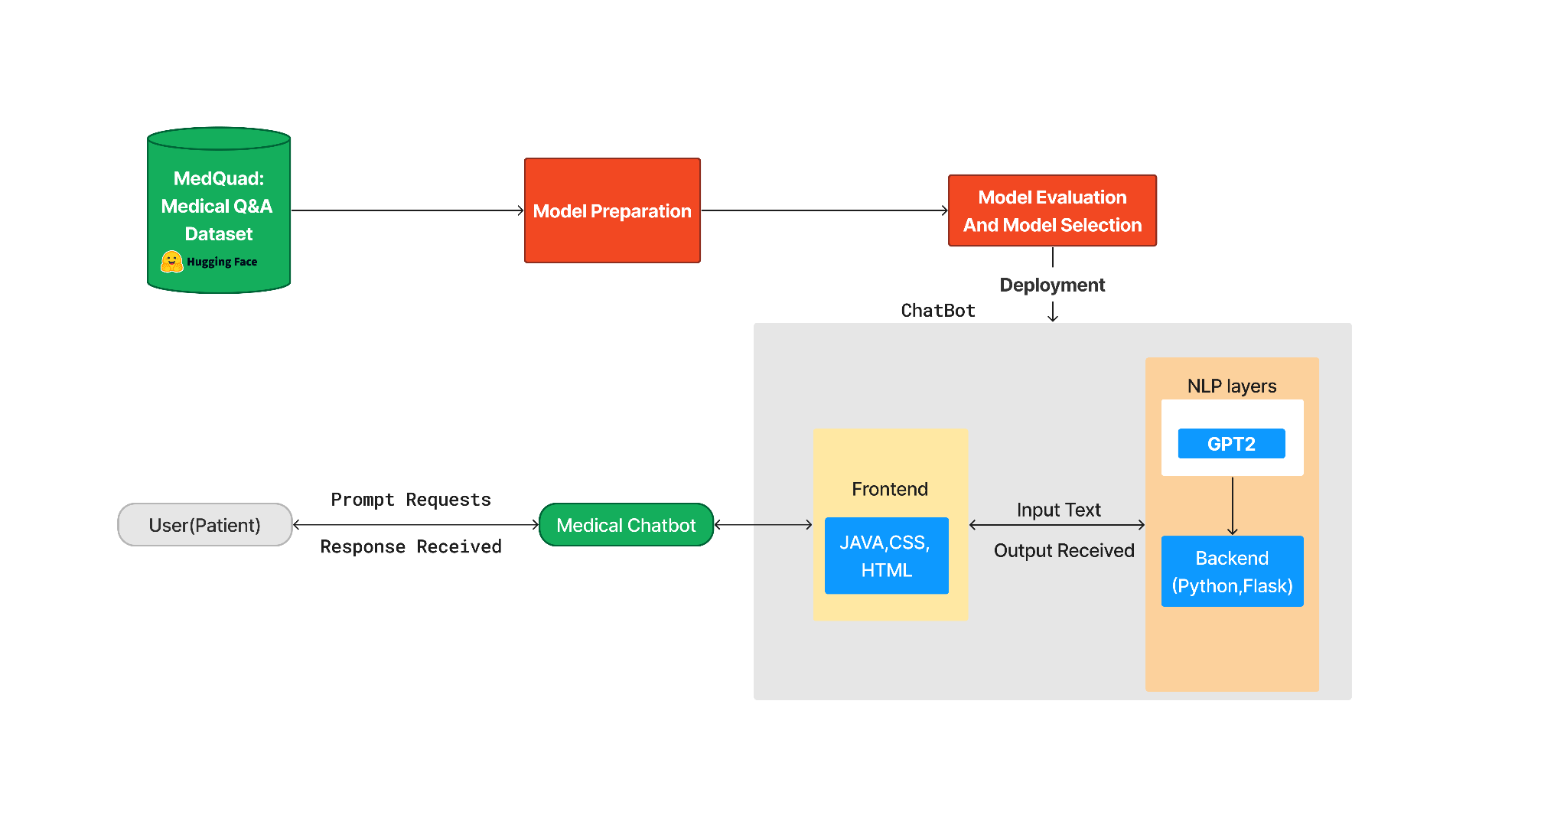
System Diagram - Methodology

Slide 6
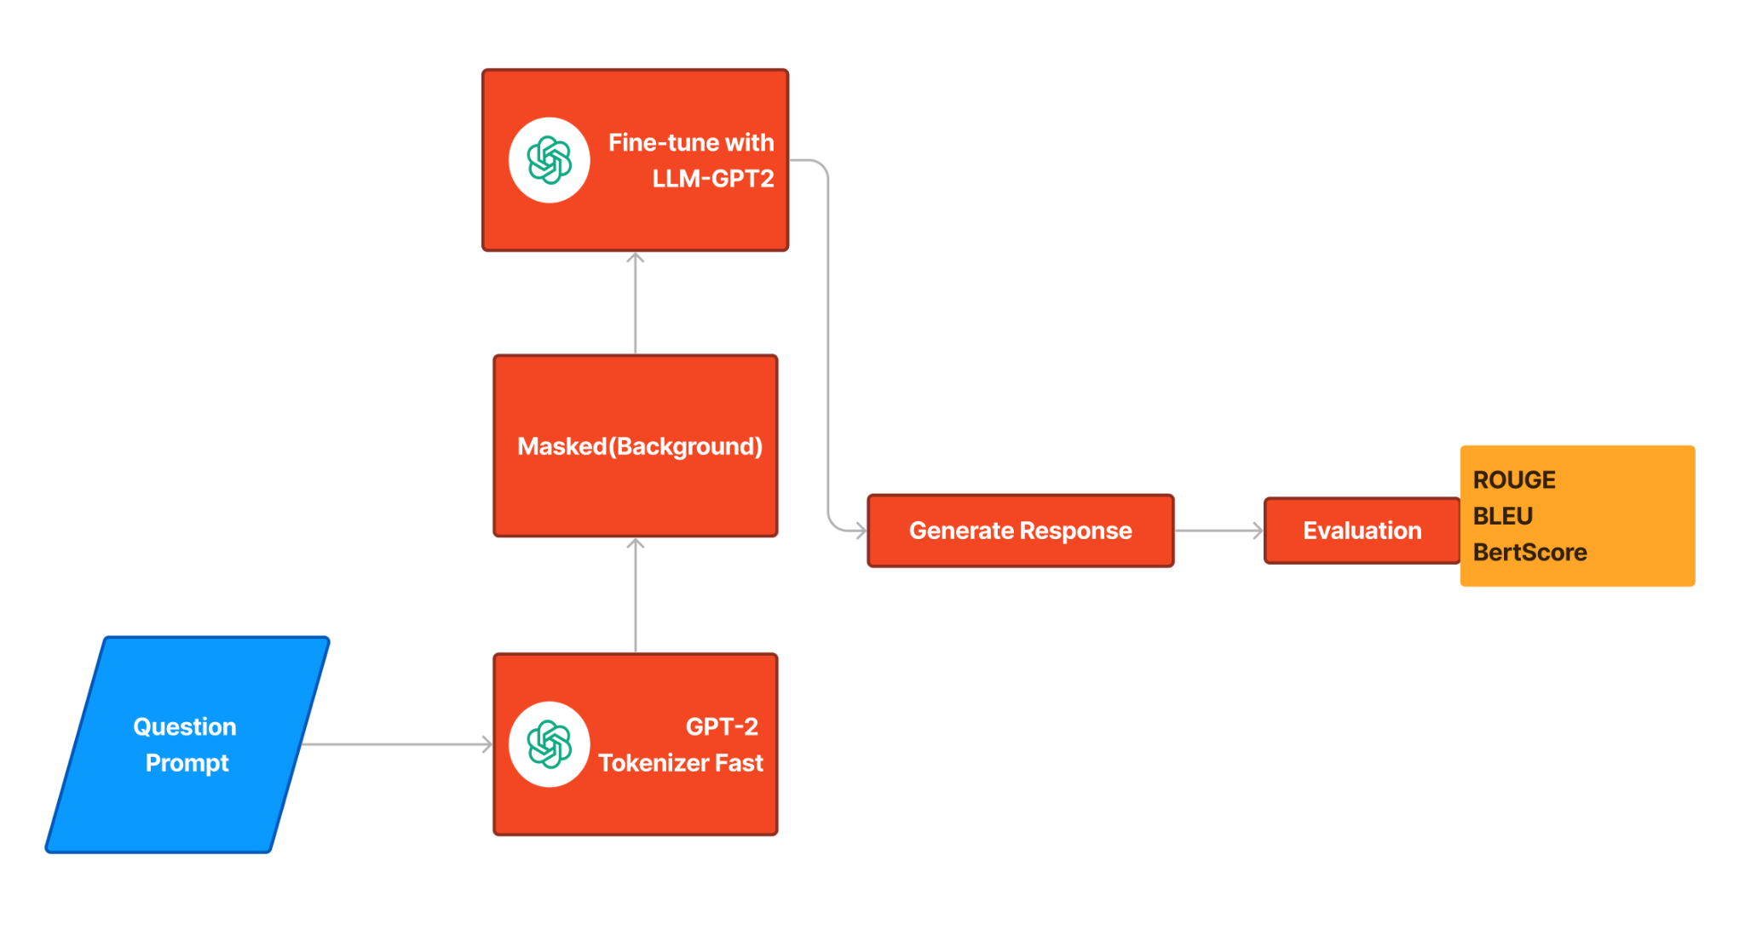
GPT-2 System Architecture

Slide 7
Methodology
Data Preparation:
Employ the MedQuad dataset, enriched with data from Huggingface and GitHub.
Conduct tokenization, numericalization, and cleansing for data integrity.
Model Development:
Experiment with Seq2Seq, GPT-2 models.
Implement advanced NLP techniques, including perplexity and seq2seq validation, for enhanced performance.
Implementation:
Select the best-performing model for further development.
Fine-tune the model on medical QA data using GPT-2.
Evaluation:
Apply a human evaluation metrics and automatic evaluation metrics, including BLEU, ROGUE.
Expand evaluation to include precision, recall, and F1-score to gauge the relevance and accuracy of medical advice.
Deployment:
Integrate with a web application for user-friendly access.
Refine the model based on user feedback and chatbot performance data.

Slide 8
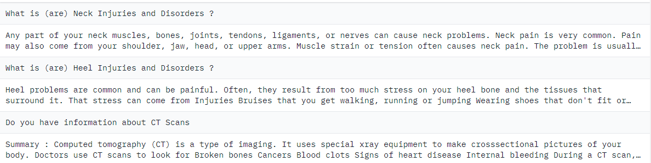
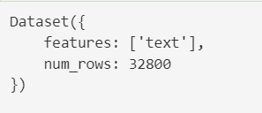
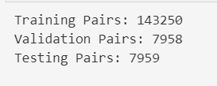
Dataset
Dataset Content:
Dataset source: Dataset from Hugging Face
Total no. of Rows in Dataset: 32800
Dataset is further split into training,validation and Testing pairs.
Training_pairs count: 143250
Validation_pairs count: 7958
Testing_pairs: 7959

Slide 9
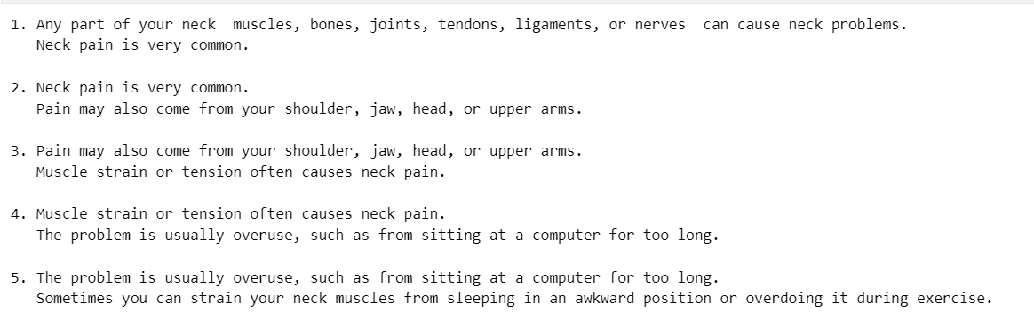
Dataset Processing
A conversational dataset is constructed by sequencing sentence pairs: each input sentence is paired with a subsequent output to train a model like Seq2Seq. This method enables the model to learn dialogue continuity and context:
Pair1: Input "What are Neck Injuries?" leads to the output "Neck muscles, bones, joints can cause problems."
Pair2: That output becomes the input for the next pair, leading to "Neck pain is common."
Pair3: Continues with "Neck pain is common," leading to "Pain can also come from shoulder, jaw, head."
This creates a cascading dialogue flow for the model to practice.

Slide 10


Tokenization
We're using the GPT2TokenizerFast from the transformers library to tokenize text efficiently for processing with the GPT-2 model.
We’re using NLTK library for carrying out the tokenization for the seq2seq model.

Slide 11
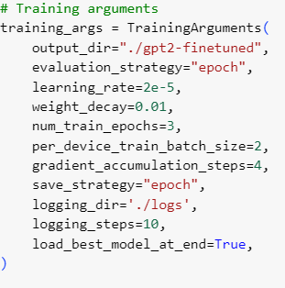
Modeling and Fine tuning
Hyperparameters for Fine Tuning GPT-2:
Evaluation Strategy: epoch
Learning Rate: 2e-5
Weight Decay: 0.01
Number of Training Epochs: 3
Hyperparameters for Seq2Seq:
Hidden Layers = 512
Number of Iterations = 15000
Teacher_forcing_ratio = 0.5
Learning Rate Encoder = 0.0001
Learning Rate Decoder = 0.0005
Optimizer = Adam Optimizer

Slide 12
Results & Evaluation
Metric | Seq2Seq | GPT-2
BLEU Score | 0.1857 | 0.3056
ROUGE Score | 0.4170 | 0.3934
Precision | 0.2648 | 0.3647
Recall | 0.1485 | 0.2485
F1 Score | 0.1723 | 0.2723
GPT-2 performs better than the Seq2Seq Model

Slide 13
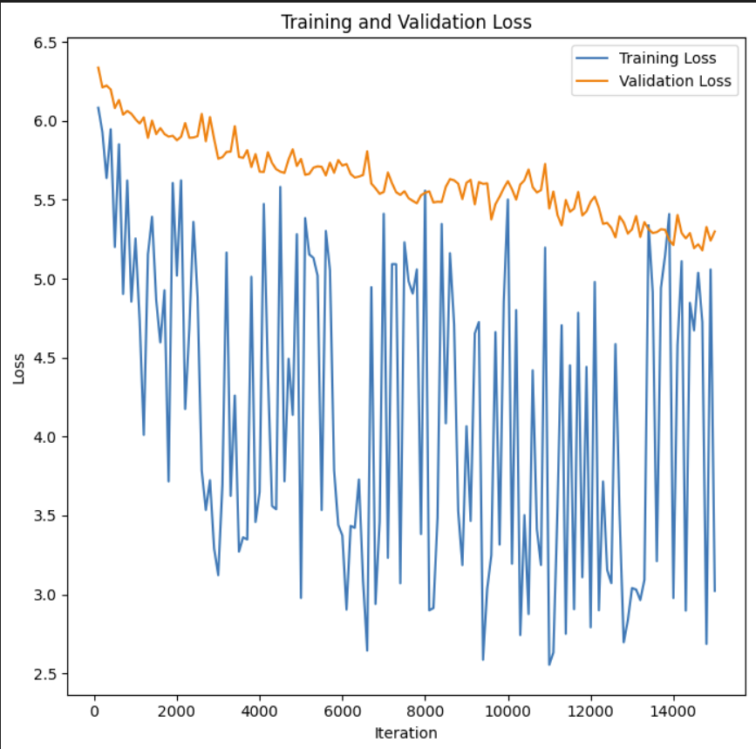
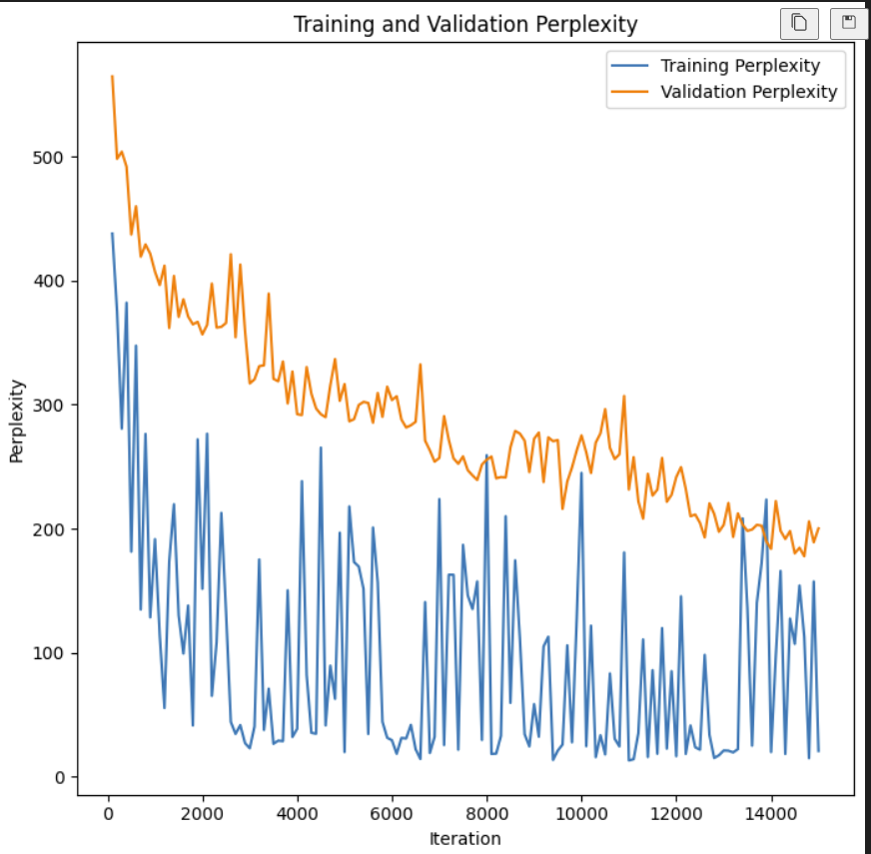
Evaluation Seq2Seq

Slide 14
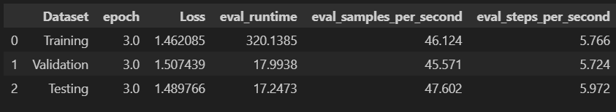
Evaluation GPT2
The average training loss over 3 epochs is 1.462085, validation loss is 1.507439 and testing loss is 1.489766.
Training loss appears to be lower than validation and testing losses
Validation and testing losses are relatively close

Slide 15
Which model
to pick?
Outperformed other models in many metrics.
Showed a gap between automated scores and human perception.
GPT2 Model ?
Outperformed by GPT-2 in most metrics.
Human evaluations indicated limitations in providing relevant medical advice.
Seq2Seq Model ?
Overall, the GPT-2 model outperformed the Seq2Seq model in most metrics, particularly in generating more relevant and accurate medical advice. The Seq2Seq model showed decent performance but lagged in human evaluation and some automated metrics.

Slide 16
Human Evaluation
Rating Scale: Ranges from 1 (Poor) to 5 (Excellent).
Evaluator Comments: Specific feedback from medical professionals, noting both strengths and areas need improvement.
Category | Rating (1-5) | Evaluator Comments (Doctors' Feedback)
Medical Accuracy | 2 | "Frequently inaccurate or overly generic, lacking specific medical detail."
Guideline Adherence | 2 | "Often fails to follow clinical guidelines, especially in complex cases."
Clarity | 3 | "Responses are understandable but sometimes use jargon that could confuse patients."
Empathy | 2 | "Struggles to convey genuine empathy, often comes off as detached."
Response Relevance | 2 | "Irrelevant or off-topic responses are common, particularly in nuanced discussions."

Slide 17
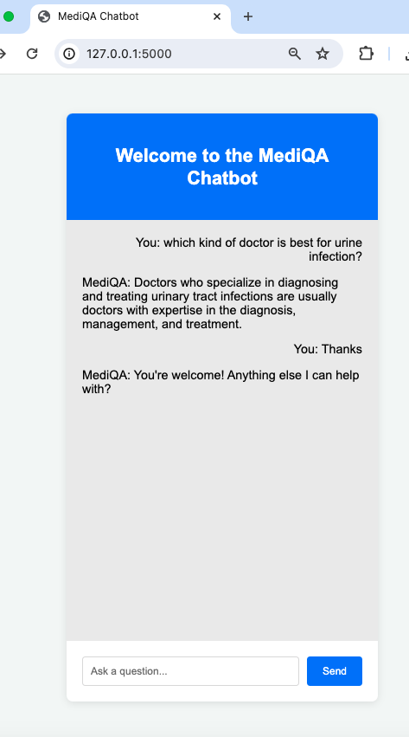
Deployment
Purpose: Instantly answers medical queries using AI.
Features: Real-time responses, handles both simple greetings and complex medical questions.
Technology: Powered by Python, Flask, and AI models via Torch and Transformers.
Benefits: Accessible 24/7 medical assistance, reduces routine workload for healthcare professionals.

Slide 18
Limitations/Future Enhancements
Limitations:
Lack of Domain Knowledge
Limited computational resources
Future Enhancements:
Experimenting with diverse datasets
Engage stakeholders, including healthcare professionals and patients, to gather feedback and ensure alignment with industry standards
Integration of human Evaluation
Implementation of sophisticated models for intent query classification

Slide 19
THANK YOU

